Slide 1
GRA – motion planning

Slide 2
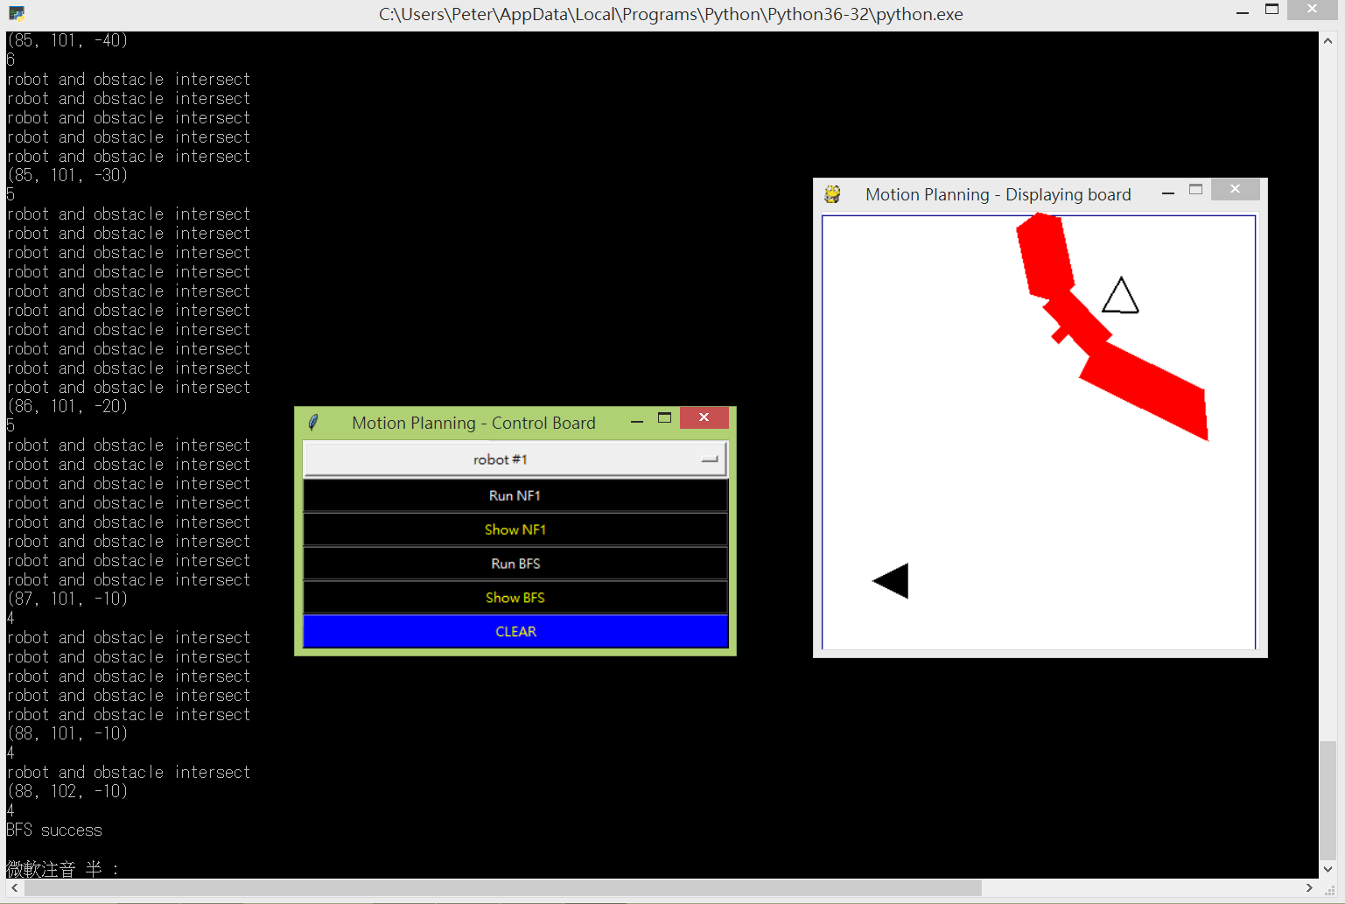
GUI
空心多邊形：robot_goal
實心多邊形：robot_recent
紅色多邊形：obstacle

Slide 3
GUI
with the neighbor configuration of FIRST in BFS OPEN, robot intersects with obstacles
configuration of FIRST in BFS OPEN
potential value of FIRST in BFS OPEN

Slide 4
兩張 map
128 * 128
(128 * scale) * (128 * scale)
H
planning
( x , y )
display
( x * scale , H – y * scale )
(0,0)
(0,0)
[ 0,0 ]
NF1
[ 127 – y , x ]

Slide 5
GRA_motion_planning.py Outline
import package
Background initialization
Define function
Define object – BFS_OPEN Define object – BFS_T
Define function – NF1
Define function – BFS
Define object – robots Define object – obstacles
Input row data
tkinter initialization
pygame initialization
main()
Package we need :
import numpy
import math
import tkinter
import pygame
import os
import platform
import matplotlib.pyplot

Slide 6
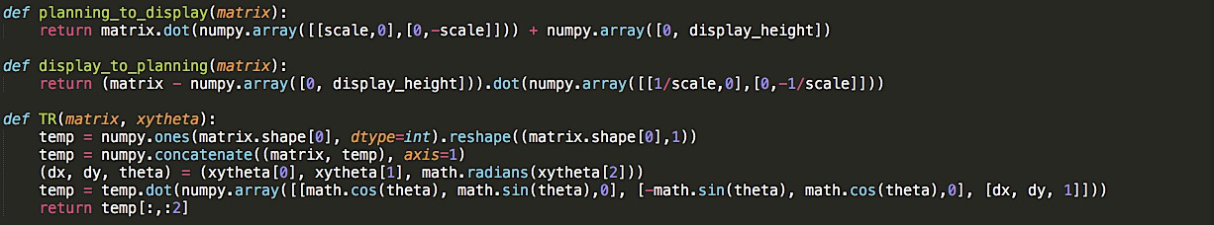
Function
planning_to_display (matrix)
planning map 的 ( x , y ) 轉成 display map 的 ( x’ , y’ )
< Parameters >
matrix : numpy.ndarray (2D)
< Return > numpy.ndarray (2D)
TR (matrix , xytheta)
對 vertices 做平移與旋轉
< Parameters >
matrix : numpy.ndarray (2D)
xytheta : list / numpy.ndarray (1D)
< Return > numpy.ndarray (2D)
display_to_planning (matrix)
display map 的 ( x’ , y’ ) 轉成 planning map 的 ( x , y )
< Parameters >
matrix : numpy.ndarray (2D)
< Return > numpy.ndarray (2D)

Slide 7
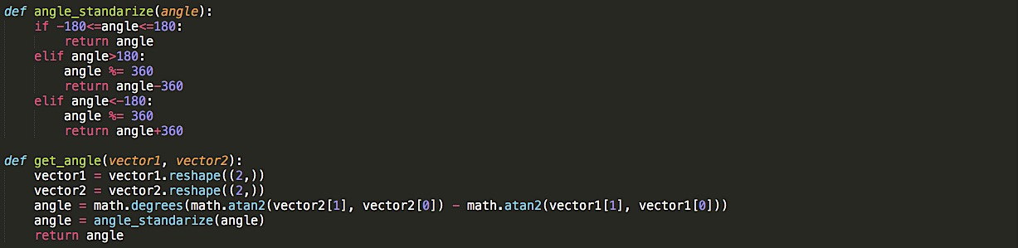
Function
angle_standarize (angle)
鎖定所有 configuration 的 theta 維持在 [ -180 , 180 ] 之間
< Parameters >
angle : float
< Return > float
get_angle (vector1 , vector2)
計算兩個向量之間的夾角
< Parameters >
vector1 : numpy.ndarray (1D/2D)
< Return > float (degrees)

Slide 8
Function
point_left (vector_of_point , vector_of_edge)
Point 是否在 edge 的左手邊 (根據edge的方向判斷)；point 與 edge 均為向量，延 edge 的角度旋轉，若 point 的 y > 0 代表在 edge 的左手邊
< Parameters >
vector_of_point : list / numpy.ndarray (1D)
Vector_of_edge : list / numpy.ndarray (1D)
< Return > boolean
vector_of_point
vector_of_edge

Slide 9
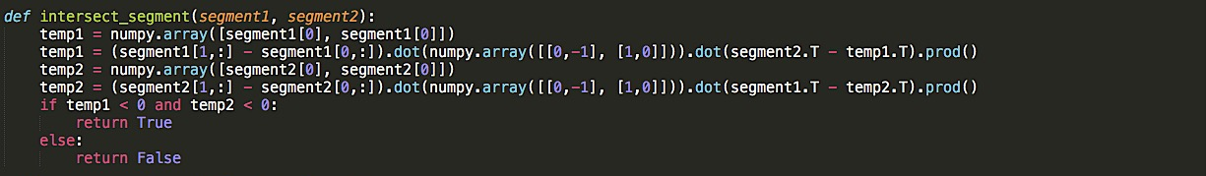
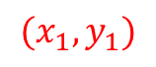
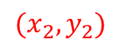
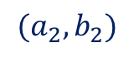
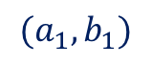
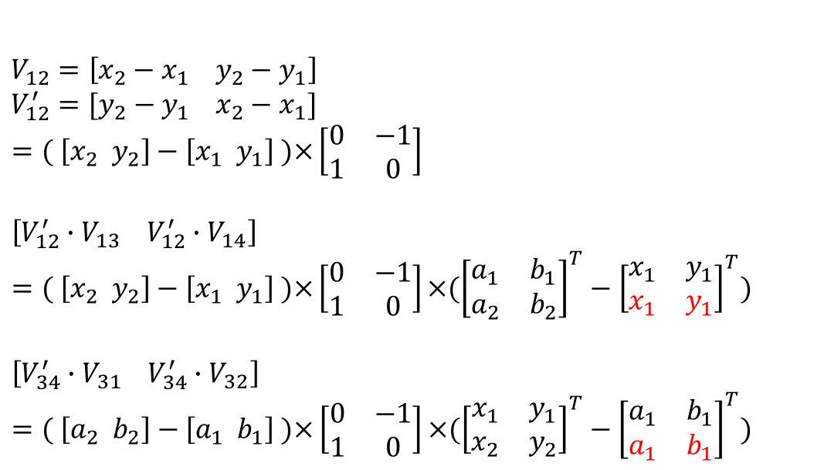
Function
intersect_segment (segment1 , segment2)
兩個線段是否相交
< Parameters >
segment1 : numpy.ndarray (2 vertices in 2D)
< Return > boolean
$$V_{12}=\left[x_{2}−x_{1} y_{2}−y_{1}\right]$$
$$V_{12}^{′}=[y_{2}−y_{1} x_{2}−x_{1}]$$
$$=( \left[x_{2} y_{2}\right]−\left[x_{1} y_{1}\right] )×\left[\begin{matrix}0 & −1 \\ 1 & 0\end{matrix}\right]$$
$$\left[V_{12}^{′}∙V_{13} V_{12}^{′}∙V_{14}\right]=( \left[x_{2} y_{2}\right]−\left[x_{1} y_{1}\right] )×\left[\begin{matrix}0 & −1 \\ 1 & 0\end{matrix}\right]×({\left[\begin{matrix}a_{1} & b_{1} \\ a_{2} & b_{2}\end{matrix}\right]}^{T}−{\left[\begin{matrix}x_{1} & y_{1} \\ x_{1} & y_{1}\end{matrix}\right]}^{T})$$
$$\left[V_{34}^{′}∙V_{31} V_{34}^{′}∙V_{32}\right]=( \left[a_{2} b_{2}\right]−\left[a_{1} b_{1}\right] )×\left[\begin{matrix}0 & −1 \\ 1 & 0\end{matrix}\right]×({\left[\begin{matrix}x_{1} & y_{1} \\ x_{2} & y_{2}\end{matrix}\right]}^{T}−{\left[\begin{matrix}a_{1} & b_{1} \\ a_{1} & b_{1}\end{matrix}\right]}^{T})$$
$$(a_{2},b_{2})$$
$$(x_{1},y_{1})$$
$$(a_{1},b_{1})$$
$$(x_{2},y_{2})$$

Slide 10
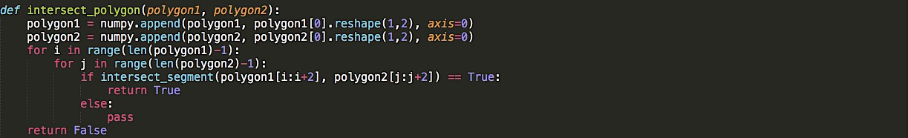
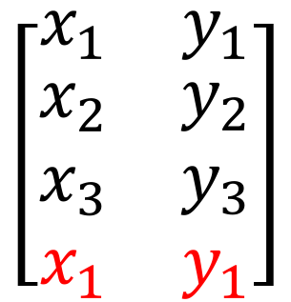
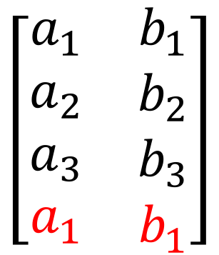
Function
intersect_polygon (polygon1 , polygon2)
兩個多邊形是否相交，檢查所有兩兩的線段
< Parameters >
polygon1 : numpy.ndarray (2D)
< Return > boolean
$$\left[\begin{matrix}x_{1} & y_{1} \\ \begin{aligned}x_{2} \\ x_{3} \\ x_{1}\end{aligned} & \begin{aligned}y_{2} \\ y_{3} \\ y_{1}\end{aligned}\end{matrix}\right]$$
$$\left[\begin{matrix}a_{1} & b_{1} \\ \begin{aligned}a_{2} \\ a_{3} \\ a_{1}\end{aligned} & \begin{aligned}b_{2} \\ b_{3} \\ b_{1}\end{aligned}\end{matrix}\right]$$

Slide 11
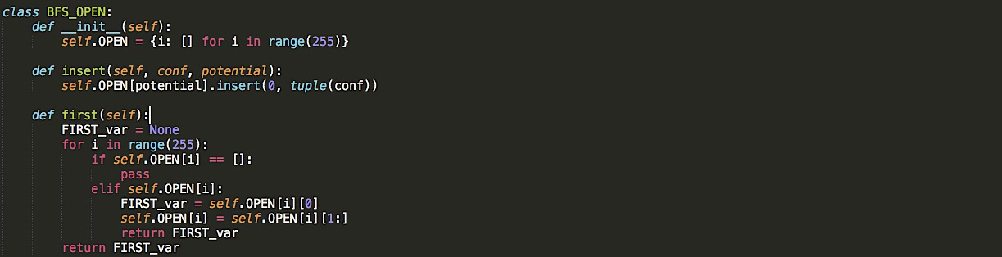
Object – BFS_OPEN
BFS_OPEN.OPEN =
{ 0 : [ ] ,
1 : [ (conf) , (conf) ] ,
…… ,
254 : [ (conf) , (conf) ] }
BFS_OPEN.insert (conf , potential)
未被拜訪過的 configuration 根據 potential (整數) 值加入 OPEN
< Parameters >
conf : tuple
potential : int
< Return > None
BFS_OPEN.first ()
若 OPEN 非空集合，取出 potential 最小的 conf；若 OPEN 為空，回傳 None
< Parameters >
< Return > tuple / None

Slide 12
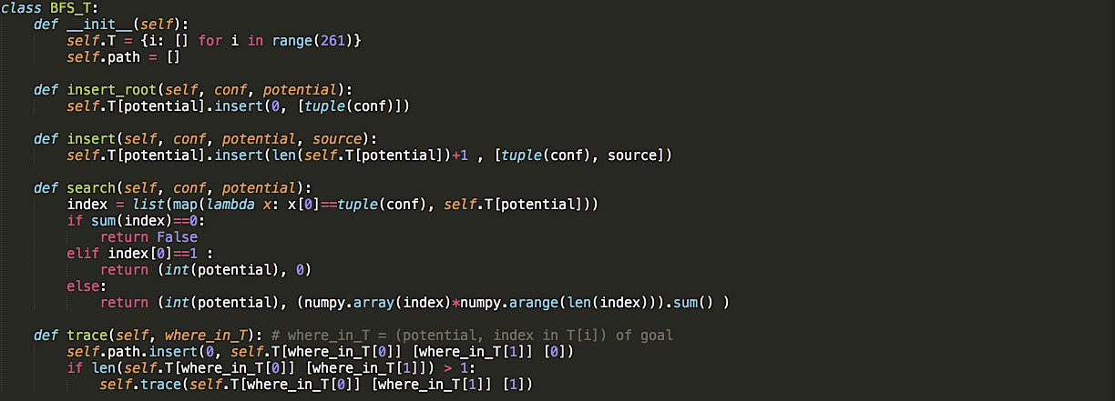
Object – BFS_T
BFS_T . T =
{ 0 : [ (conf) ] ,
1 : [ [ (conf) , (source) ] , [ (conf) , (source) ] ]
…… ,
260 : [ [ (conf) , (source) ] , [ (conf) , (source) ] ] }
(source) = 來源在 T tree 所在的位置

Slide 13
Object – BFS_T
BFS_T.insert_root (conf , potential)
control point 的起點加入T tree
< Parameters >
conf : tuple
potential : int
< Return > None
BFS_T.insert (conf , potential , source)
未被拜訪過的 neighbor 加入T tree
< Parameters >
conf : tuple
potential : int
source : tuple
< Return > None
BFS_T.search (conf , potential)
neighbor 是否存在 T tree 裡面，有的話回傳位置，沒有的話回傳 False；同時作為 visited or not 的判斷
< Parameters >
conf : tuple
potential : int
< Return > tuple / False
BFS_T.trace (where_in_T)
search 到 goal 的時候，根據所在的 T tree 位置，回傳 path 陣列
< Parameters >
where_in_T : tuple
< Return > list

Slide 14
Robots – Class
self.planning_conf = ( x , y , theta ) in planning map
self.planning_control
self.planning_polygon
self.planning_bounding_box
(0,0)
planning map

Slide 15
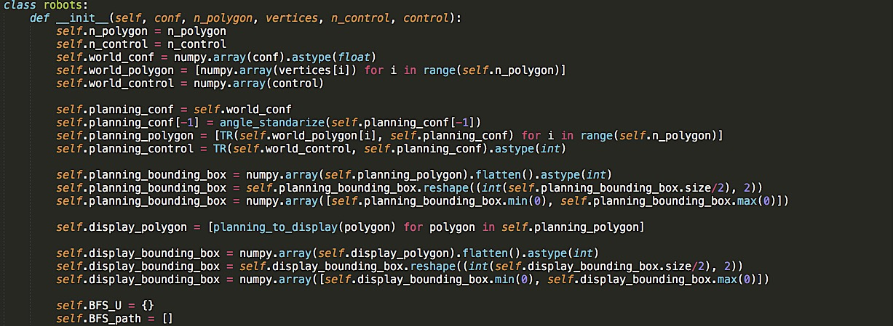
Robots – Class
<Parameters>
conf : tuple/list
n_polygon : int
vertices : list and counterclockwise ordered (3D)
n_control : int
control : list (2D)

Slide 16
Robots – Class.function
robots.mouse_inside (mouse_position)
游標是否落在 robot 的bounding box裡面；使用在物件拖移
< Parameters >
mouse_position : list (1D)
< Return > Boolean
robots.displaty_draw (game , color , width = 0)
物件畫在 display map
< Parameters >
game : pygame.display
color : tuple
< Return > None

Slide 17
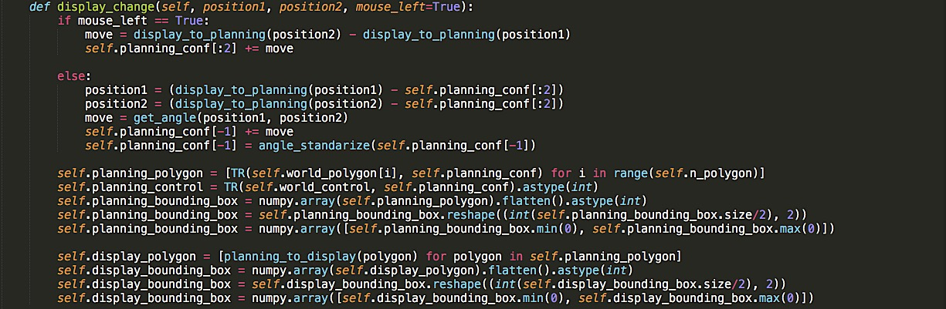

Robots – Class.function
左鍵：
move = $(dx , dy)$
右鍵：
move = theta
robots.displaty_change (position1 , position2 , mouse_left = True)
物件被拖移時，先更改 planning map 的屬性，再反映在 display map
< Parameters >
position1 : numpy.ndarray (1D)
< Return > None

Slide 18
Obstacles – Class
self.planning_conf = ( x , y , theta ) in planning map
self.planning_polygon
self.planning_bounding_box
(0,0)
planning map

Slide 19
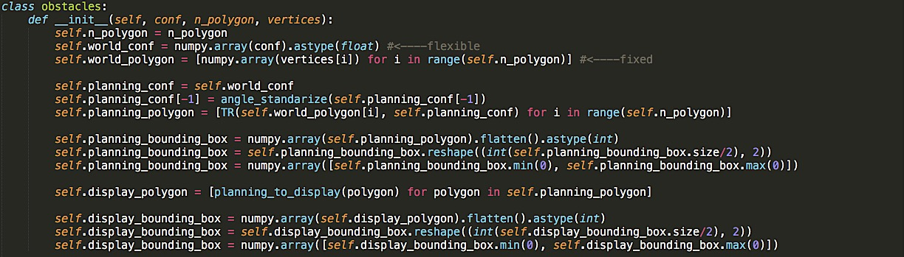
Obstacles – Class
<Parameters>
conf : tuple/list
n_polygon : int
vertices : list and counterclockwise ordered (3D)

Slide 20
Obstacles – Class.function
obstacles.mouse_inside (mouse_position)
游標是否落在 obstacle 的bounding box裡面；使用在物件拖移
< Parameters >
mouse_position : list (1D)
< Return > Boolean
obstacles.displaty_draw (game , color , width = 0)
物件畫在 display map
< Parameters >
game : pygame.display
color : tuple
< Return > None

Slide 21
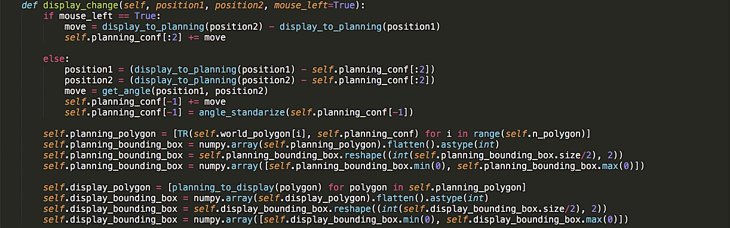
Obstacles – Class.function
左鍵：
move = $(dx , dy)$
右鍵：
move = theta
obstacles.displaty_change (position1 , position2 , mouse_left = True)
物件被拖移時，先更改 planning map 的屬性，再反映在 display map
< Parameters >
position1 : numpy.ndarray (1D)
< Return > None

Slide 22
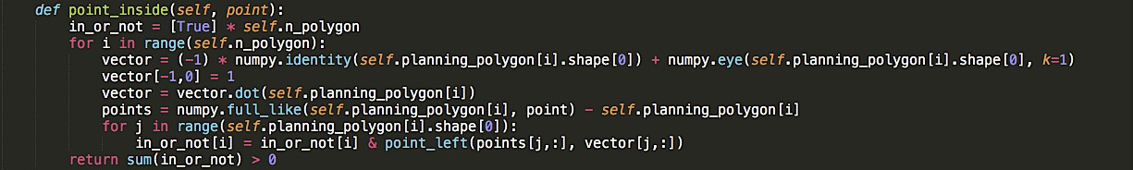
Obstacles – Class.function
obstacles.point_inside (point)
計算 potential field 時，要把 obstacle 內部的點都填滿 ( potential ← 260 )，做為判斷的function
< Parameters >
point : tuple/list (1D)
< Return > Boolean

Slide 23
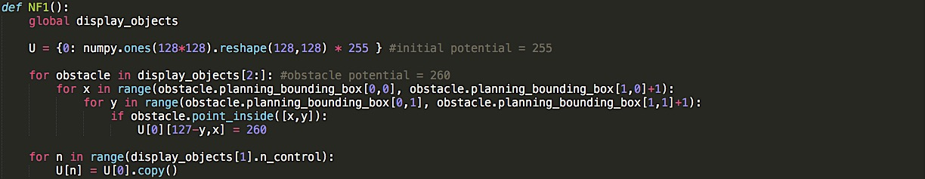
Function – NF1
U = { 0 : numpy.ndarray ,
1 : numpy.ndarray }
[ 0,0 ]
Potential field (shape = 128 * 128)
initial = 255
obstacle = 260
U[ i ][ 127 – y , x ]
NF1
[ 127 – y , x ]
Order of control point

Slide 24
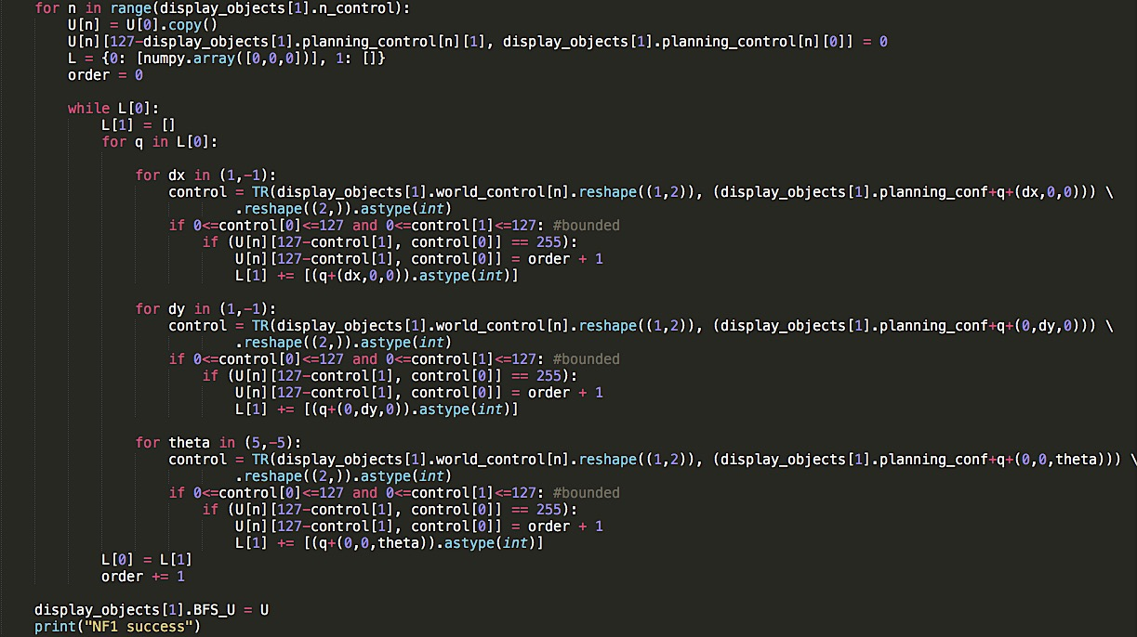
→ Potential field 儲存在 robot_goal 物件

Slide 25
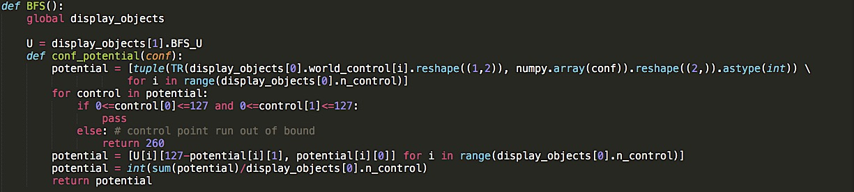
Function – BFS
conf_potential (conf)
根據 configuration 找出 planning_control 的位置，再找儲存在 robot_goal 裡面的 potential field，用平均的方式 ( sum( potential ) / n_control )得到 potential 值
< Parameters >
conf : tuple
< Return > int

Slide 26
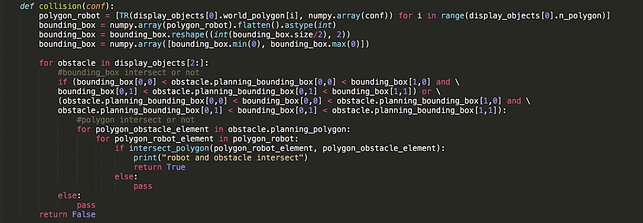
Function – BFS
collision (conf)
根據 configuration 找出 polygon 的位置，檢查是否有碰撞
< Return > Boolean

Slide 27
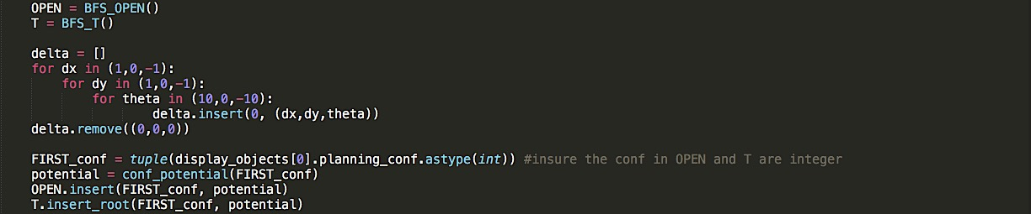
Function – BFS
→ to insure the configurations in OPEN and T are integer

Slide 28
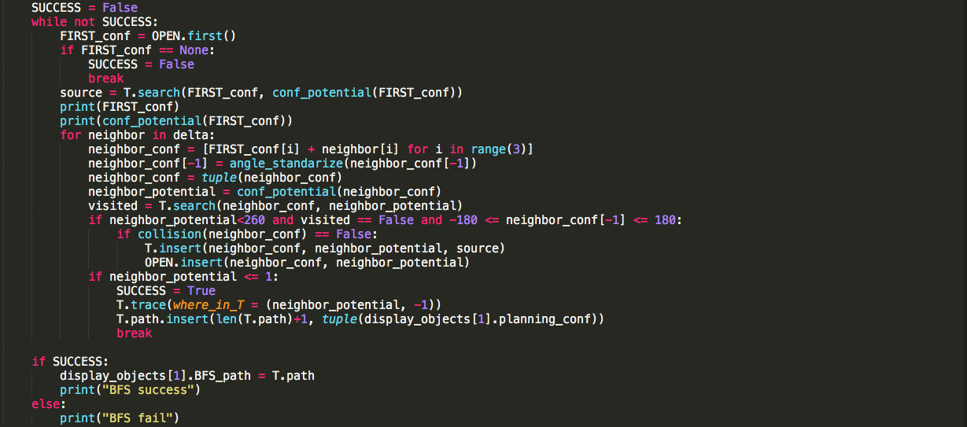
Function – BFS

Slide 29
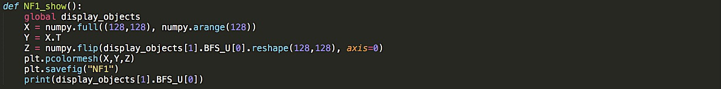
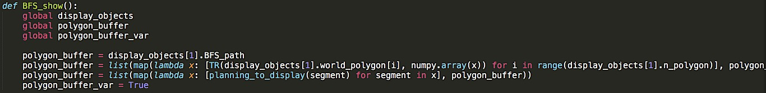
Function – NF1_show , BFS_show
Save the potential field into file: NF1.png
Show part of potential field to remind user

Slide 30
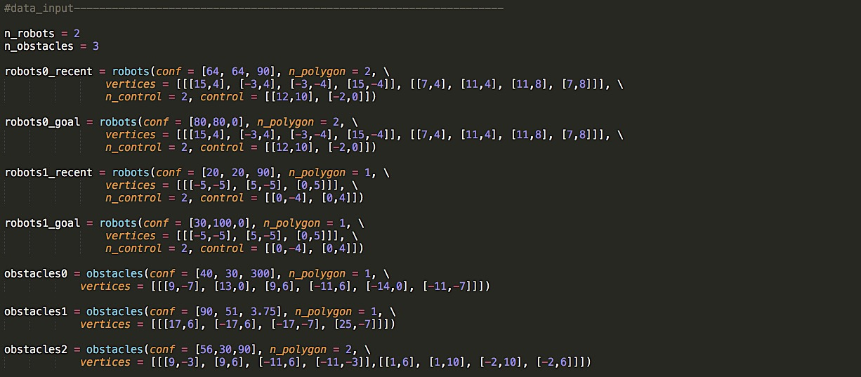
Input Data

